Slide 1
School Shootings
By: Jake Pullen

Slide 2
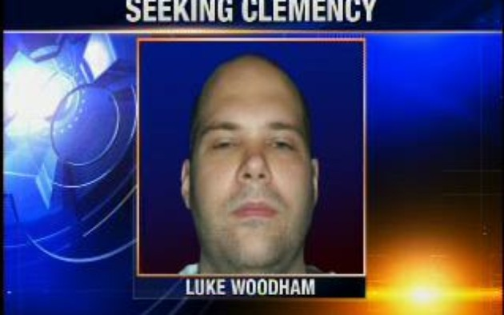
Oct. 1, 1997 Pearl, Miss. Two students killed and seven wounded by Luke Woodham, 16, who was also accused of killing his mother. He and his friends were said to be outcasts who worshiped Satan.

Slide 3
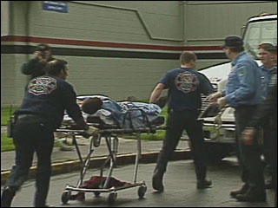
May 21, 1998 Springfield, Ore. Two students killed, 22 others wounded in the cafeteria at Thurston High School by 15-year-old Kip Kinkel. Kinkel had been arrested and released a day earlier for bringing a gun to school. His parents were later found dead at home.

Slide 4
Blacksburg, Virginia, April 16, 2007: A student killed 32 students and faculty at Virginia Polytechnic and State University in the worst single act of gun violence in U.S. history.

Slide 5
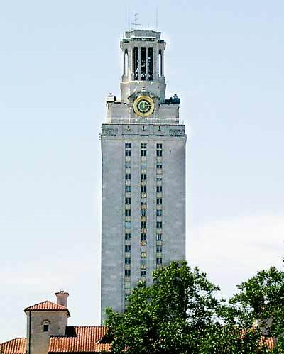
Austin, Texas, August 1, 1966: A University of Texas student and former Marine killed 16 people and wounded 32 others in and around the campus. He was shot dead by a police officer.

Slide 6
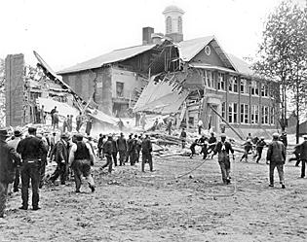
Bath Township, Mich., May 18, 1927: Forty-five people were killed and 58 injured, including 38 elementary students, in three bombings by a school board treasurer enraged by higher taxes in the deadliest act of violence at a U.S. school.

Slide 7
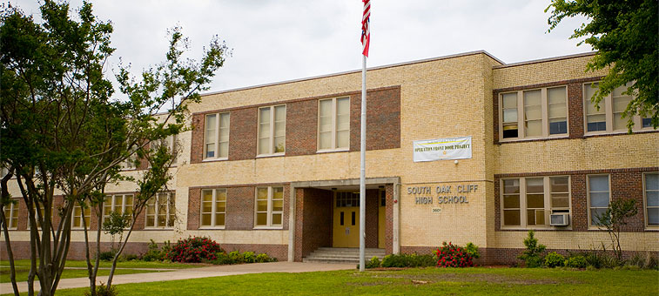
South Oak Cliff High School, Dallas, Texas- Wednesday, October 8, 1986
With classes done for the day, students loaded up on school buses and waited for them to take them home. About 50 students were on one of the buses when a heated exchange of words began between two boys in the back of the bus. One of them was a 16-year-old sophomore named Cody Cobbins. The other was an unnamed 17-year-old boy. The two boys began to argue at 4:00 over one of the bus seats. Before either boy could throw a punch at the other, the driver of the bus intervened and sent Cody to the front of the bus. As Cody made his way up the aisle, the older brother of his opponent, 19-year-old Kenneth Lee Jackson, pulled out a .22-caliber pistol and shot him in the lower back. Cody was transported to Methodist Medical Center where he was pronounced dead an hour later.

Slide 8
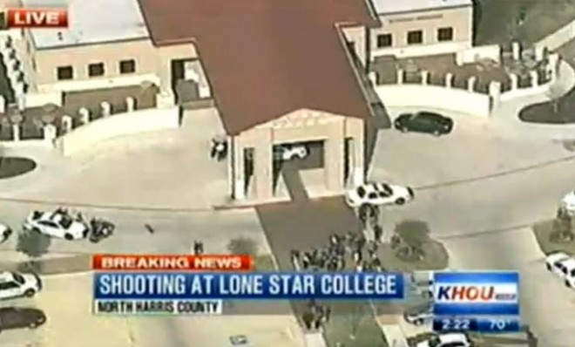
Lone Star College Shooting January 22, 2013: 4 Injured In Texas College Shooting: The most recent shooting. Although nobody was killed, it was still a scare for many all around.

Slide 9
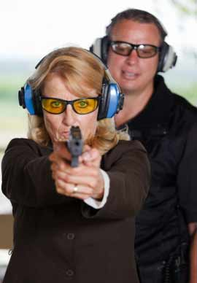
Since February 5, 2010, a total of 57 people have been killed in school shooting. Can we fix the problem? Possibly, having teachers that have a concealed hand guns license. Schools around our area have already taken the initiative to do this.

